Slide 1

Tutorial for
High Throughput pathway interpretation and analysis
Kinza Rian
kinza.rian@juntadeandalucia.es
Clinical Bioinformatics Research Area, HVR
hipathia.babelomics.org

Slide 2
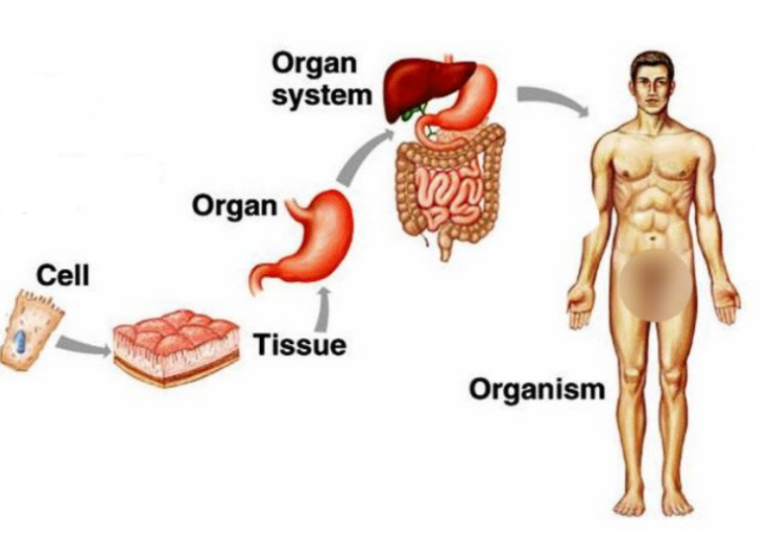
Introduction

Slide 3
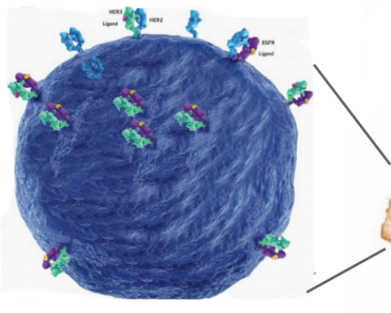
Introduction

Slide 4
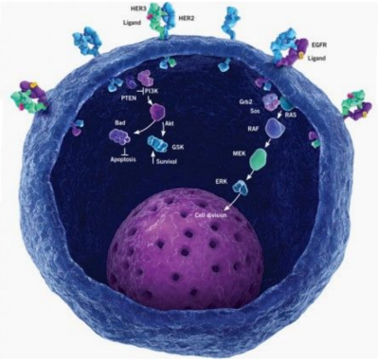
Introduction

Slide 5
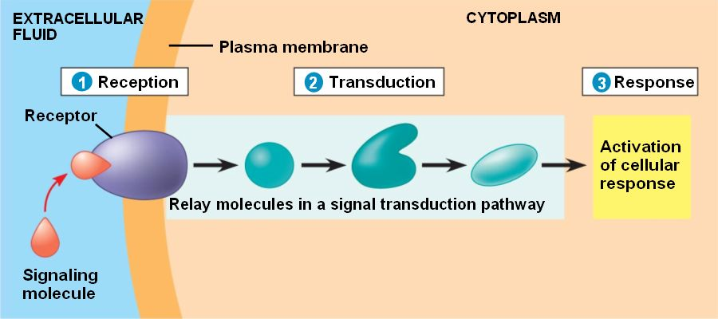
Signaling pathway
Chemical signals
Hormones
Neurotransmiters
Growth factors
Cytokines
Drugs
Cellular Function
Apoptosis
Survival
Growth
Migration
Proliferation
Activation & Inhibition
Phosphorilation
Dephosphorilation
Glycosylation
Ubiquitination
Methylation

Slide 6
From cell to pathways

Slide 7
From cell to pathways

Slide 8
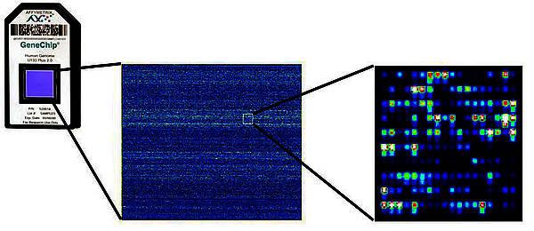
From cell to pathways

Slide 9
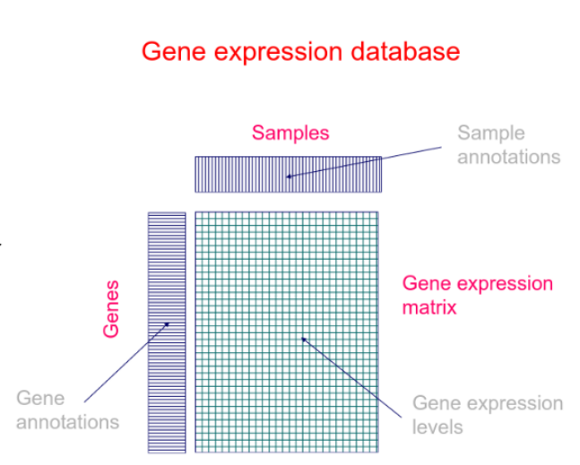
From cell to pathways

Slide 10
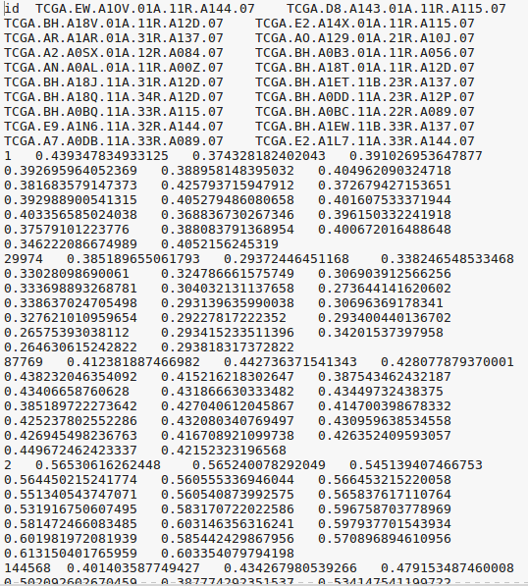
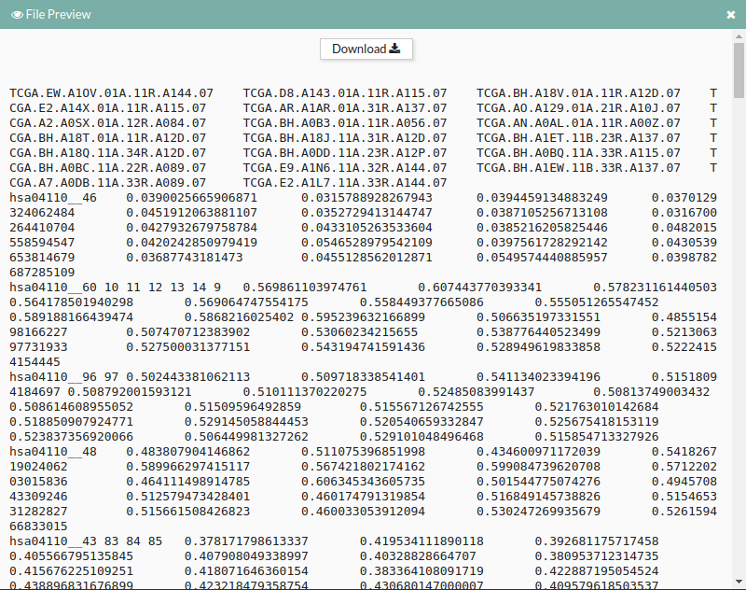
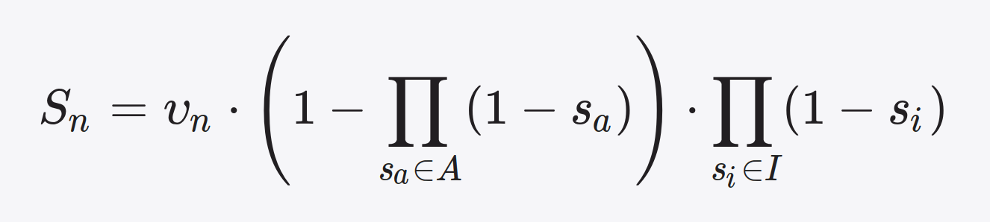
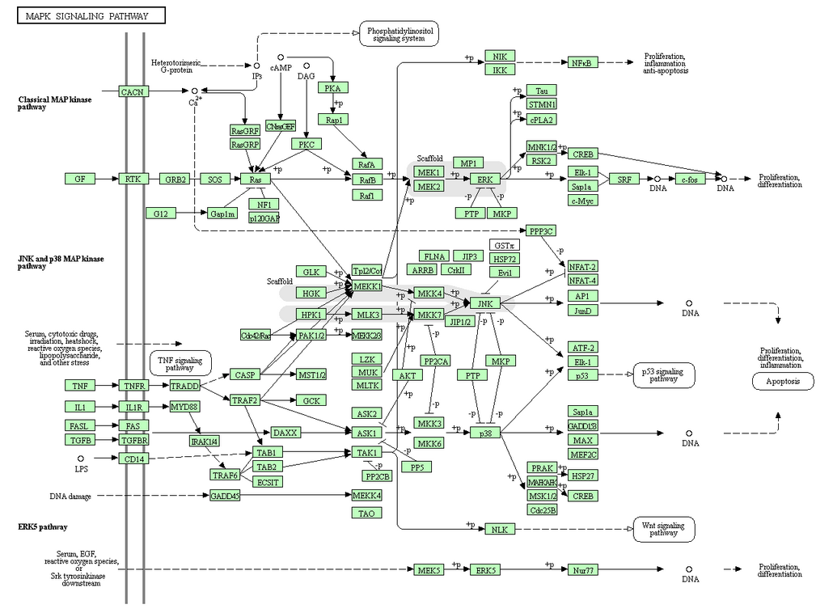
Overview / Our aim
Case Vs Controls
Case Vs Controls
Case Vs Controls
Normalized genes
Raw Data
Signaling pathways /circuits
Activity
We seek for a simple transformation of raw data (normalization) and an algorithm that result in accurate estimations of signaling circuit activities.

Slide 11
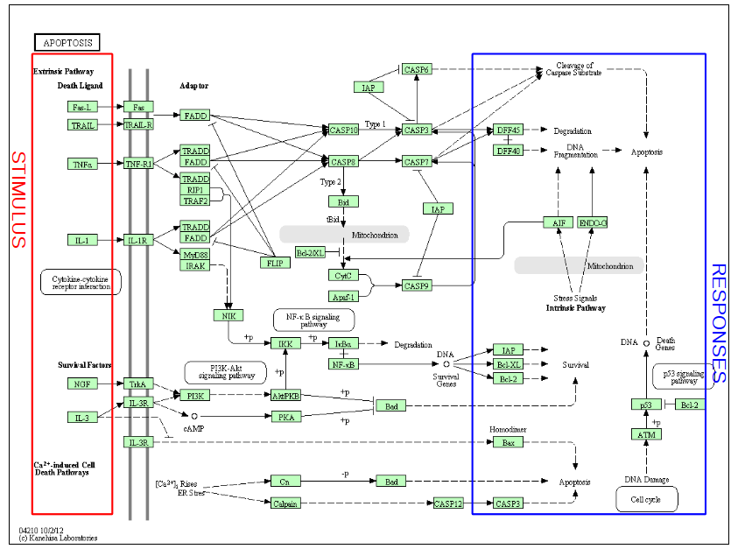
Pathways layout
Take pathways
information

Slide 12
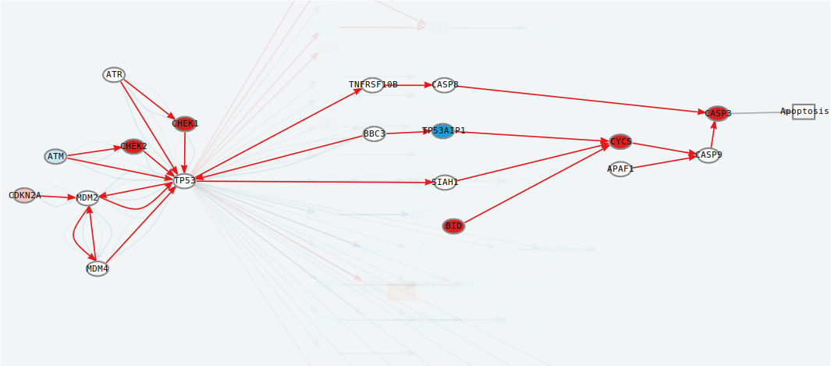
Meaningful subpathways
Effector subpathway
> Subpathway including any node from any receptor to one effector protein

Slide 13
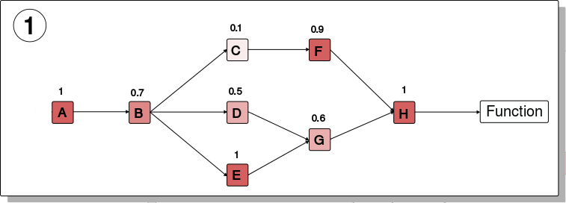
Computing the signal
Compute a node score based on the expression.

Slide 14
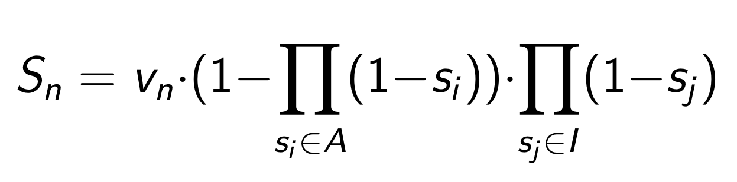
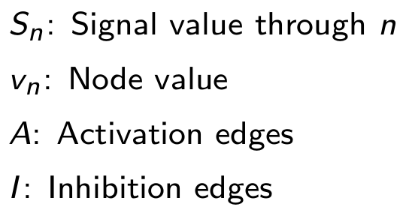
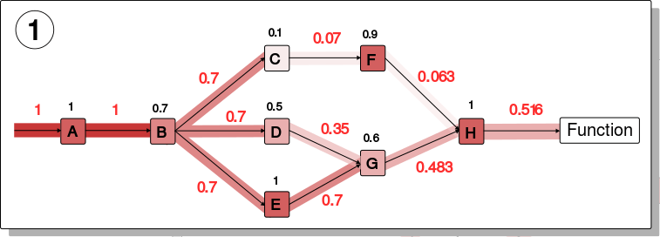
Computing the signal
Compute a node score based on the expression.
Compute signal passing through each node n.

Slide 15
Signal values
Input signal 1 in any input node
Compute the signal through each node iteratively
Loops can be processed
Subpathway signal: last node signal

Slide 16
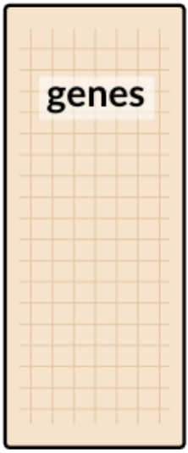
Functional annotation
Samples
Gene A
Gene B
Gene C
.
.
.
.
.
.
.

Slide 17
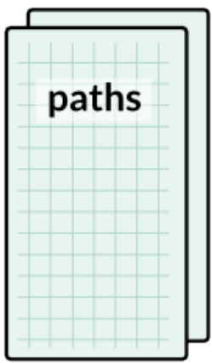
Functional annotation
Estimate effector proteins activation
Samples
Samples
Gene A
Gene B
Gene C
.
.
.
.
.
.
.
Path 1
Path 2
Path 3
.
.
.
.
.
.
.

Slide 18
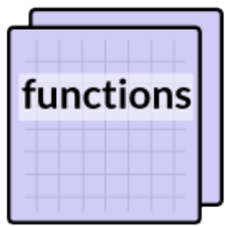
Functional annotation
Estimate effector proteins activation
Annotate effector proteins functions
Samples
Samples
Samples
Gene A
Gene B
Gene C
.
.
.
.
.
.
.
Path 1
Path 2
Path 3
.
.
.
.
.
.
.
F1
F2
F3
.
.
.
.

Slide 19
Functional annotation
Estimate effector proteins activation
Annotate effector proteins functions
Uniprot keywords
GO annotation
Samples
Samples
Samples
Gene A
Gene B
Gene C
.
.
.
.
.
.
.
Path 1
Path 2
Path 3
.
.
.
.
.
.
.
F1
F2
F3
.
.
.
.

Slide 20
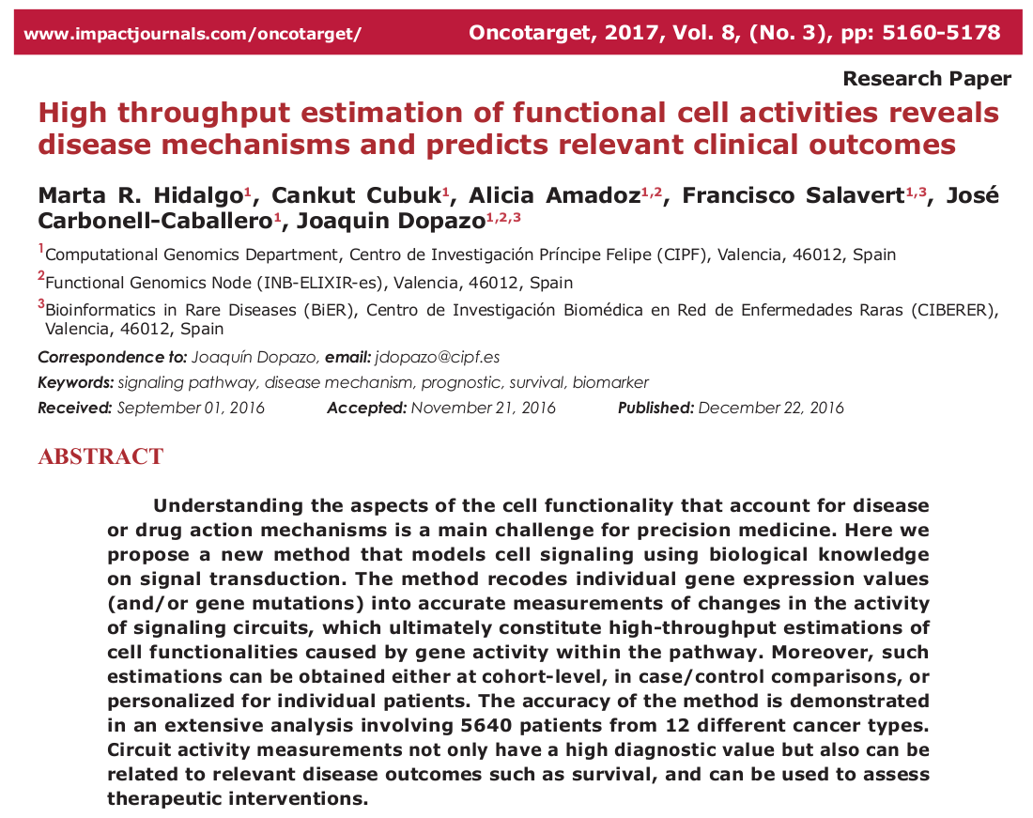

Slide 21


Slide 22
Case stady: Breast Cancer
We will work with a Breast Cancer dataset from the repository The Cancer Genome Atlas:
http://hipathia.babelomics.org/doc/doku.php?id=worked_example_differential_example

Slide 23
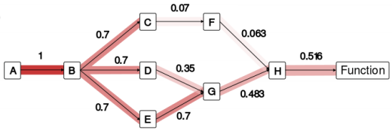
Perturbation effect tool
In our model, signal transduction is usually modulated through all nodes between a membrane receptor and an effector protein
Membrane Receptor
Effector protein
Intracellular signaling proteins

Slide 24
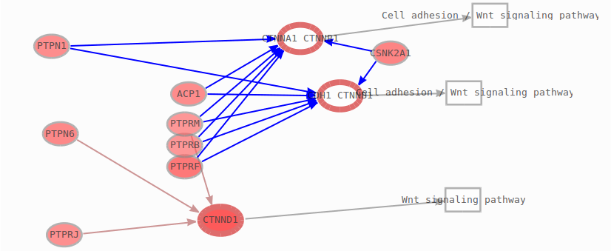
Perturbation effect tool
This approach offers a powerful framework to design targeted therapies with minimum resources.

Slide 25
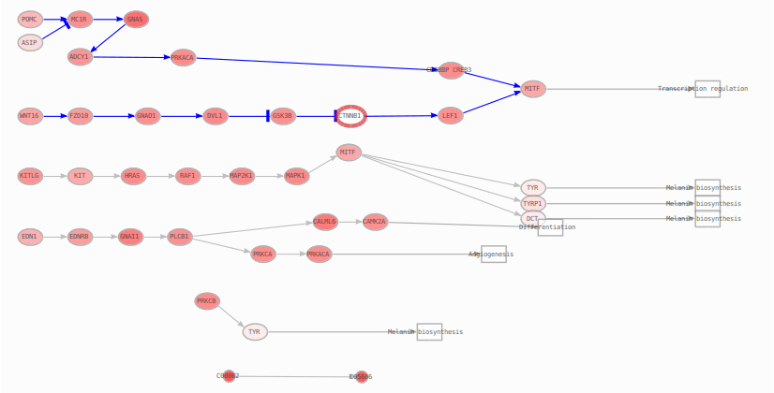
Perturbation effect tool
We can use the same machinery to virtually explore the consequences of knocking out (or overexpress) a gene in signal transduction.

Slide 26

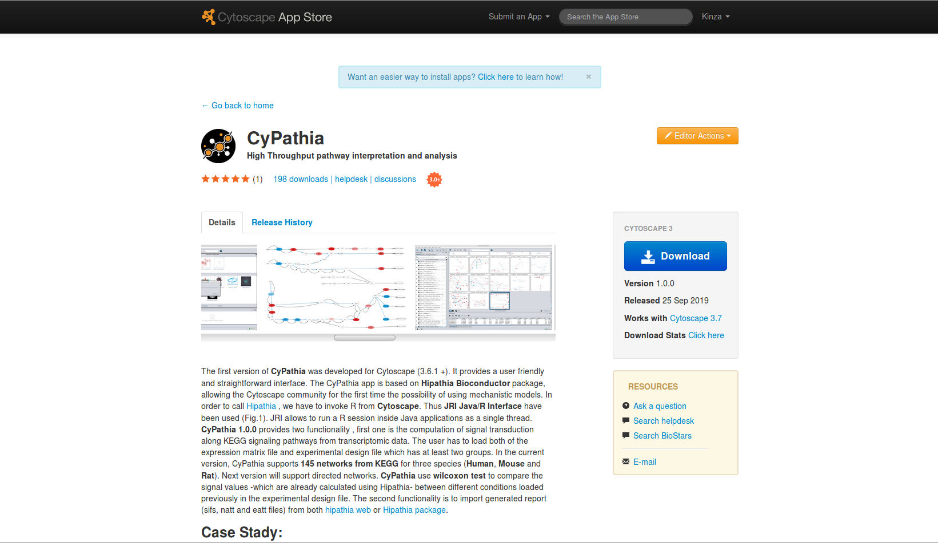
CyPathia

Slide 27
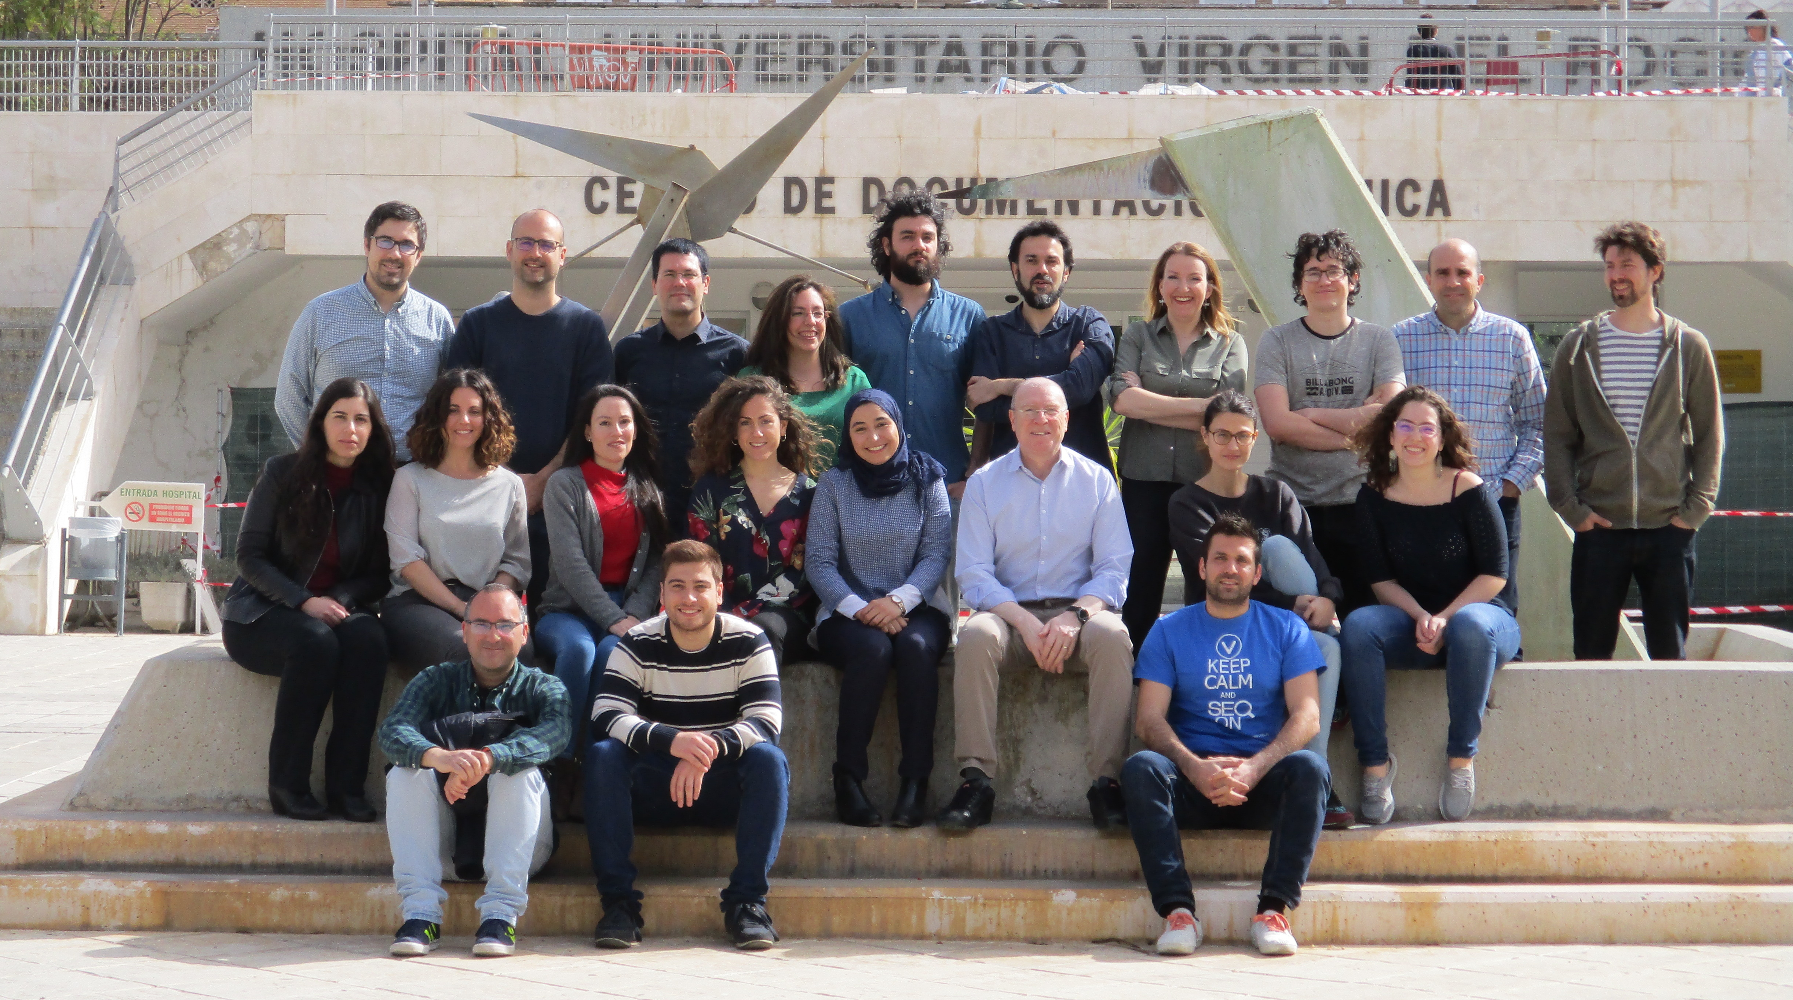
@ClinicalBioinfo

